Slide 1



Discrepancies between population and estimates and official enrolment data and the implications of this for across-province funding equity
Martin Gustafsson
September 2025

Slide 2
Contents
Introduction
Some global history
Population and enrolment data in SA
Debates around the equitable share formula
New findings on provincial equitable shares issues

Slide 3
Introduction
Education planners in South Africa have been aware for many years that official estimates of the young population exceed what enrolment data suggest by just over 10%.
Discrepancies (often in the opposite direction) are common in developing countries.
It is widely accepted that these discrepancies mean school participation rates need to be measured from a single source, i.e. household data.
What is less clear is how the discrepancies skew funding for provincial schooling systems, and how anomalies may be fixed.
What you’ll see here is partly covered in published work, but new paper by DBE analysts in the pipeline.

Slide 4
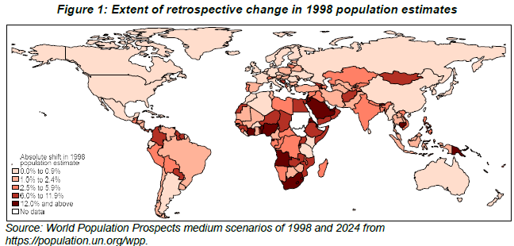
Some global history
Measurement of population
Largest absolute adjustments in India, Nigeria and South Africa.
In UN system, ±50 countries (including SA) said to draw from ‘1974-2009 Education Stats’ in estimates of fertility, but not clear how. Probably grade enrolments without repetition adjustments.

Slide 5
Some global history (contd.)
Measurement of population
Despite interesting alternatives, the ideal of a national census every ten years seems to stand firm.
Measurement of enrolment
Up to 1980s, even in developed countries extensive use of school survey forms collecting aggregates common.
Rounding to nearest multiple of five, and other anomalies, common in some of these data based on grade-specific totals.
Today learner-level data the norm in developed countries, and becoming increasingly common in developing.
1

Slide 6
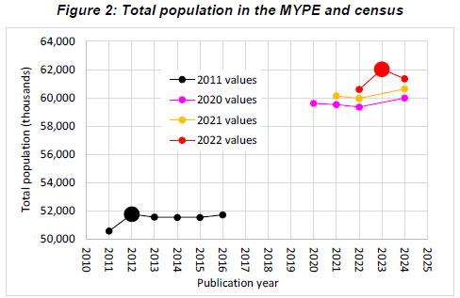
Population and enrolment data in SA
Measurement of population
Originally envisaged national census every five years in 1999 Statistics Act has given way to global norm of decadal census.
National censuses have tended to result in upward revisions of MYPE estimates falling a little short of actual census totals.

Slide 7
Population and enrolment data in SA (contd.)
To date, enrolment data has not been used by Stats SA for estimating the population.
Measurement of enrolment
2017 marked the first year that official enrolment figures were based on individual-level data.
The 2003-2005 births surge (strictly speaking, surge in birth cohorts):
  A surge of 15%, which remains under-researched, appeared in enrolment data from 2011, and was largely unexpected. Also reflected in birth registrations data.
  MYPE began reflecting this in 2013, a decade after the start of the rise in births.
Transfer of anonymised learner-level data to DataFirst occurred last week!
2

Slide 8
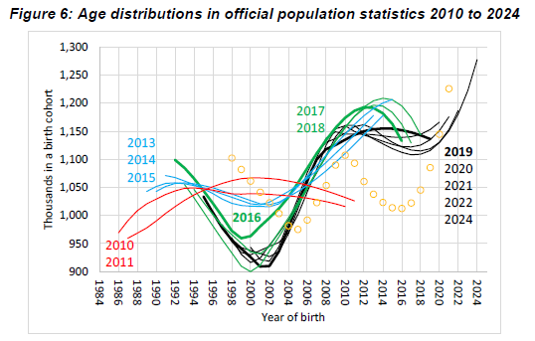
Population and enrolment data in SA (contd.)
In MYPE 2011, no post-2003 births surge. In 2013 MYPE, births rise of 12% seen. In 2019 MYPE, this became 26%, thus exceeding increases seen in enrolment data.
13%
26%
0%

Slide 9
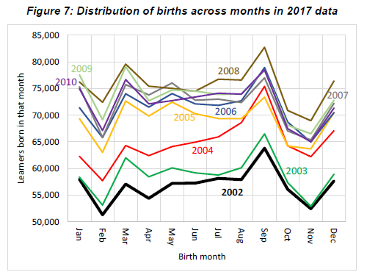
Population and enrolment data in SA (contd.)

Slide 10
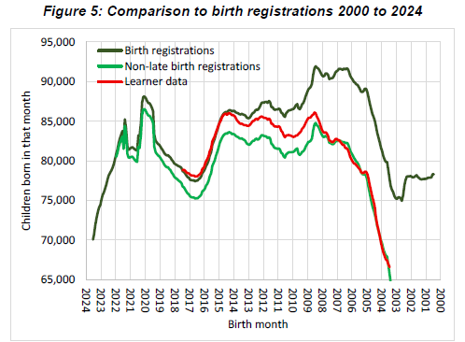
Population and enrolment data in SA (contd.)
Enrolment data highly consistent internally from year to year, and considerable consistency with birth registrations data found, though there are questions.
Since birth year 2014, very close alignment.
15% increase in post-2003 births in birth registrations data.
Younger
This gap would be partially explained by worse child mortality in this period.

Slide 11
Debates around the equitable share formula
Much of the debate has consisted of certain provinces arguing for province-specific cost-drivers (e.g. small schools in Eastern Cape) to be taken into account, and Treasury responding that if such drivers are not reflected in policy, formula revisions are not justified.
The last Budget Review clear that two policy-anchored cost-drivers to be incorporated: special school enrolments and provincially differentiated pro-poor funding of non-personnel supplies.
  However, these two largely cancel each other out, producing minimal net differences to final provincial weights.

Slide 12
New findings on provincial equitable shares issues
Enrolment data are of course not population data, but they get close considering 99% participation levels at critical ages.
Linear extrapolation is feasible, and hardly changes provincial weights relative to using ages 8 to 13.

Slide 13
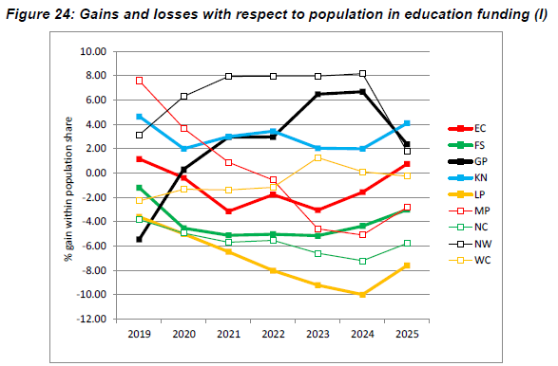
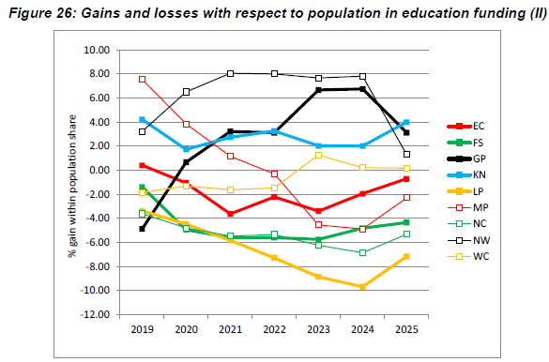
New findings on provincial equitable shares issues (contd.)
Ideally, all provinces would sit at zero.
Values should be halved to reveal budgetary impact (population part in formula is 50%, rest is enrolment).
Some convergence in most recent year.
Almost identical pattern with extrapolations.

Slide 14
Pointers for policymakers and analysts
Policymakers
We (specifically, Stats SA) should move towards better use of learner-level enrolment data in estimating young population.
Population must be used in equitable share, but phasing in estimates informed by DBE data would promote inter-provincial equity.
Analysts
New learner-level data about to become available on DataFirst provide new opportunities for analysing demographics, school efficiency, etc.
More broadly, analysis of expenditure equity in the schooling system is needed in a context of much concern in the public debates.
3

Slide 15
Publicly available analysis
Department of Basic Education (2018). Per learner spending inequities in 2016. Pretoria. [3]
Department of Basic Education (2023). Grade promotion, repetition and dropping out 2018 to 2021: Data report. Pretoria.
Gustafsson, M. (2015). Enrolment ratios and related puzzles in developing countries: Approaches for interrogating the data drawing from the case of South Africa. International Journal of Educational Development, 42: 63-72. [1]
Gustafsson, M. (2016). Understanding trends in high-level achievement in Grade 12 mathematics and physical science. Pretoria: Department of Basic Education. [2]

